Slide 1

Online Shopping Survey Presentation By- Kshitija BARGE Intern At ChRomatus Consulting

Slide 2
An Internship is such a program that makes a student experiences corporate life for the first time. At Chromatus Consulting we were assigned as Data Analyst Intern. We were part of the Data Analyst Team. We used Python, R Language and our project was to find business cases.
During the first month of the internship, we were given a dataset related to “Car modification”. We used these data tables and predicted the future values for Car modification market. We used R Language and time series to predict these values.
During the second month, our Sir, Mr. Vijay Natekar conducted a workshop related to SPSS. We learned all the basic functions and use of SPSS for analysis during this workshop. He also conducted a short workshop related to AI and its applications.
During the third month, we were told to do a project. Our project topic is “Analysis of Healthcare companies”. We collected secondary data using Google search and used Python for further EDA and model building.
The Below report is based on our statistical knowledge and three months' work experience at Chromatus Consulting as a Data Analyst intern.

Slide 3
Objectives :
Identify buying habits of customers based on multiple factors.
To identify the factors influencing online shoppers and consumers.
To study the customer's level of satisfaction regarding online shopping.
To identify the concerns of customers.
To identify changes in shopping during pandemic.

Slide 4
Data Collection
We Created a Questionnaire related to Online Shopping Survey and Collected the Primary Data Using Google Forms.
DATA COLLECTED FROM : https://docs.google.com/forms/d/e/1FAIpQLSeZbAvBntGlxD4bL2_VXupe0Z3yEiwICDKyuAjAp8d5I7JIA/viewform

Slide 5
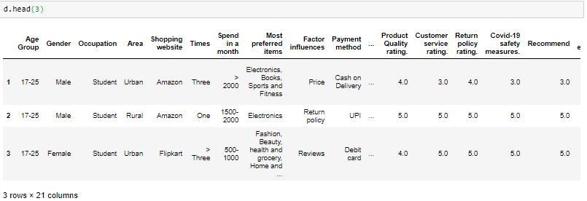
Data
['Age Group', 'Gender', 'Occupation ', 'City', 'Area', 'Shop online', 'Shopping website', 'Times', 'Spend in a month', 'Most preferred items', 'Factor influences', 'Payment method', 'Delivery service rating', 'Product Quality rating.', 'Customer service rating.', 'Return policy rating.', 'Covid-19 safety measures.', 'Recommend', 'Overall experience.', 'Is user friendly', 'Comfortable', 'Ad influence', 'Privacy concerns', 'Purchasing pattern changed', 'Biggest concern', 'Continue shopping', 'Switch to ?']

Slide 6
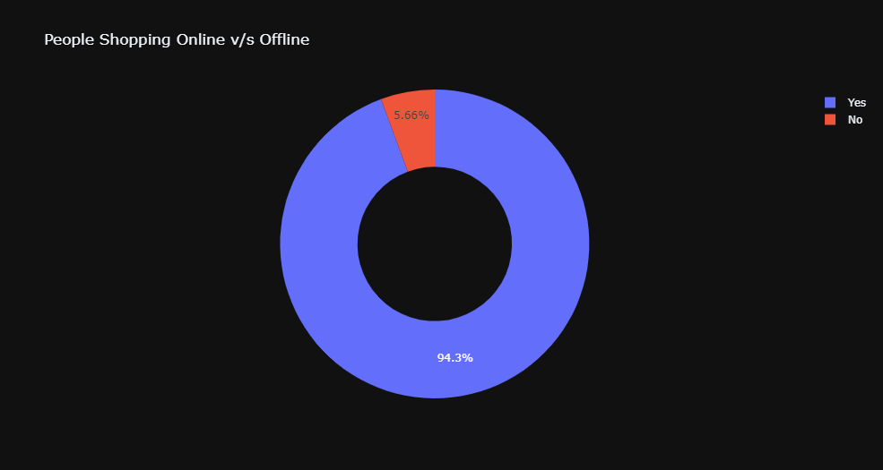
Pie Diagram : People Who Shop online V/s Offline
Conclusion: 94.3 % of people prefer online shopping.

Slide 7
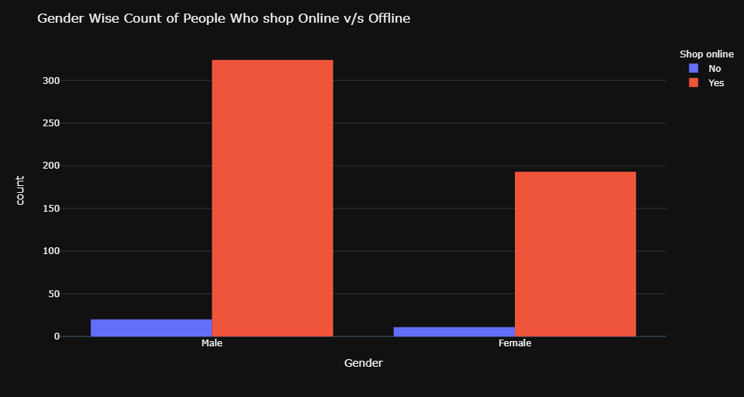
Gender Wise Visualisation of People who Shop Online v/s who Don’t
Conclusion : 324 Males out of 344 shop online, 193 Females out of 204 shop online.

Slide 8
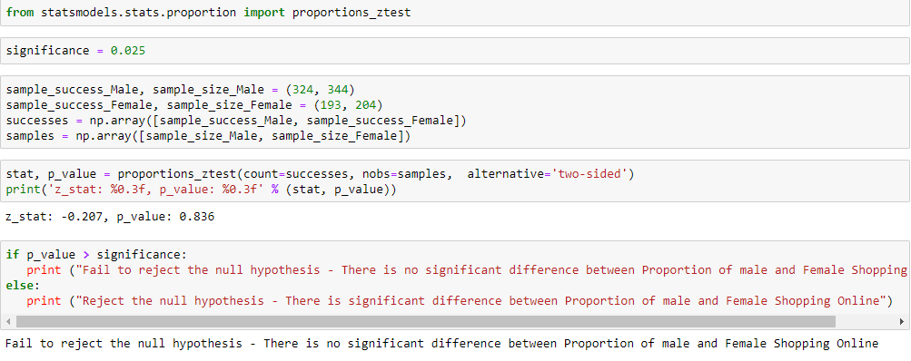
Is there any significant difference between the proportion of males and females shopping online?
Conclusion : There is No Significant Difference Between Proportion of Males and Females Shopping Online.

Slide 9
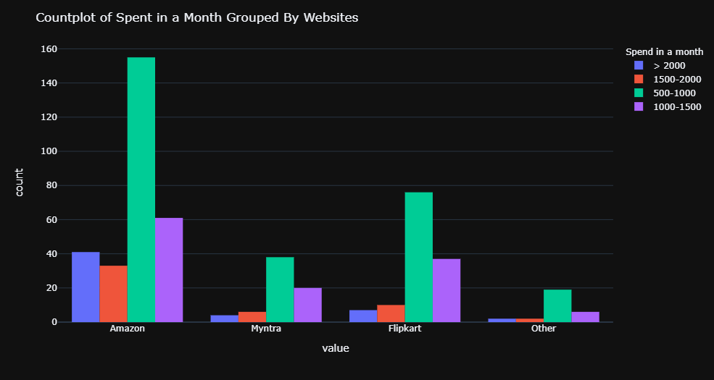
Money Spent in A Month Grouped by Websites
Conclusion : Products >2000 Rs. Contributes More for Amazon in comparison with its Competitors.
Flipkart and Myntra Must Focus on Products in that Category to Increase Overall Sales.

Slide 10
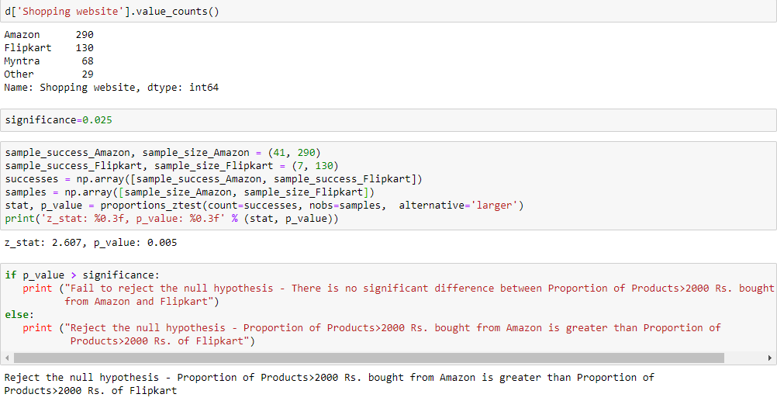
To Prove the Case Statisticaly
Conclusion : Proportion of Products >2000 Rs Bought From Amazon is Greater in Comparison With other Companies.

Slide 11

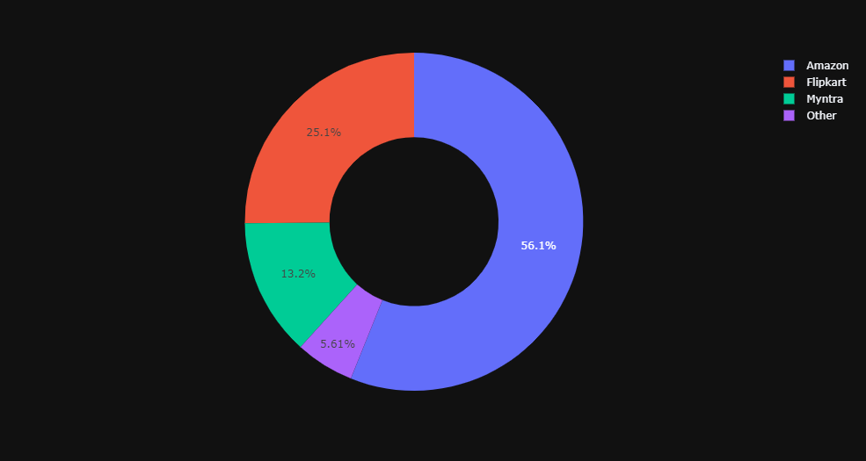
Drop Records For those Who Don’t Shop Online
index_names=d[d['Shop online']=='No'].index
d.drop(index_names, inplace = True)
Which is the Most Preferred Website ?
56.1 % Of Users Prefer Amazon

Slide 12
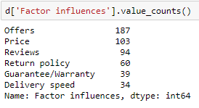
Overall Factor that Influences Customers the Most
Conclusion: Offers influences Buyers the Most on Online Shopping Website.

Slide 13
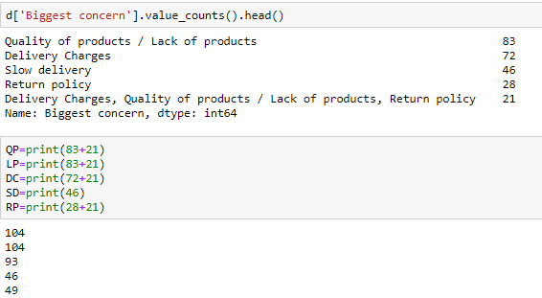
Customer's Biggest Buying Concern
Conclusion: Quality of Products and Lack of Products Concerns Most of Customers

Slide 14
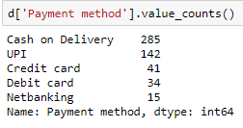
Most Preferred Payment Method
Conclusion: Cash on Delivery followed by UPI are mostly preferred by Buyers

Slide 15
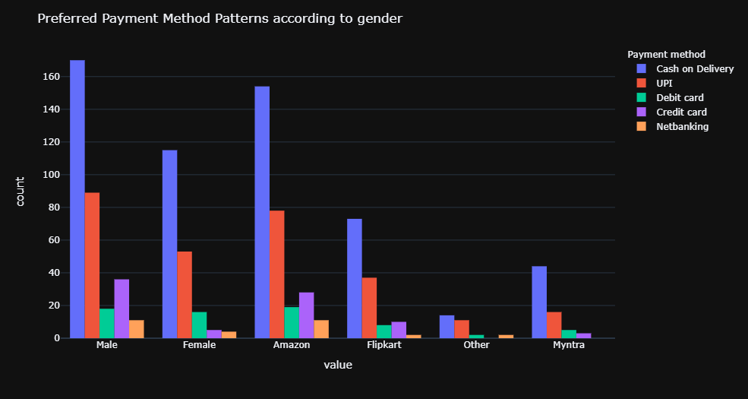
Preferred Payment Method Patterns according to gender and websites
Conclusion : 1] Myntra user donot prefer net banking option.
2] Males Prefers Credit card over Debit card for shopping which is not the same in case of females.

Slide 16
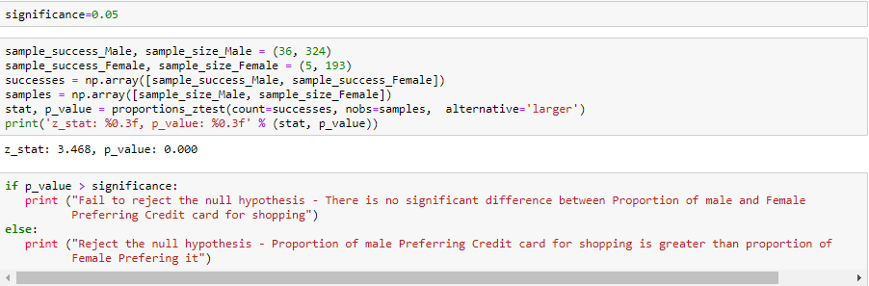
36 Males out of 324 shop Using Credit Card, 5 Females out of 193 shop Using Credit Card Is there any significant difference between the proportion of males and females using Credit cards for shopping?
Conclusion : The Proportion of Males Preferring Credit Card for Shopping is Greater than Proportion of Females Preferring it.

Slide 17
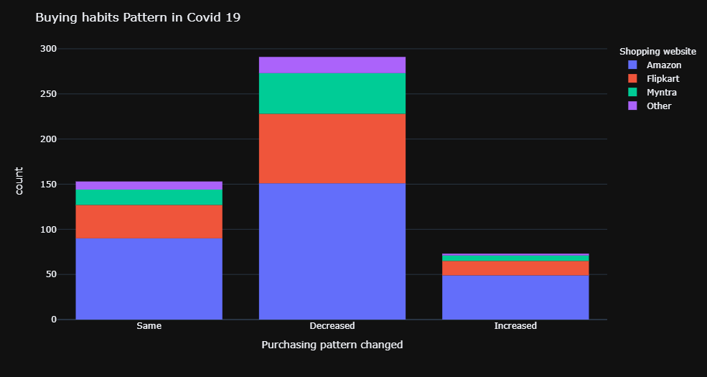
Overall Buying pattern in Covid-19 situation ?
Conclusion : Overall Buying pattern in Covid-19 situation seems to be decreased.

Slide 18
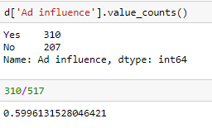
Does Advertisement make an Influence on Buyers ?
Conclusion : 60% Percent of Buyers say “YES”, Advertisements do Influence them in Buying Online

Slide 19
Grouping Data w.r.t to Websites for further Analysis
d1= d.groupby('Shopping website')
fig,ax = plt.subplots(figsize=(16,16))
sns.heatmap(d1.corr(),annot =True,linewidths=0.2,cmap='coolwarm’)
Conclusions :
Amazon: Overall online experience, recommendation
Flipkart: Overall online experience, recommendation
Myntra: Overall online experience , Return policy rating, recommendation
What’s Different ? : Overall online experience is not much correlated with the Return policy rating in case of Amazon and Flipkart but is strongly correlated in the case of Myntra.
i.e. Overall online experience of Customers buying through Myntra is higher. May be due to their good return policy.

Slide 20

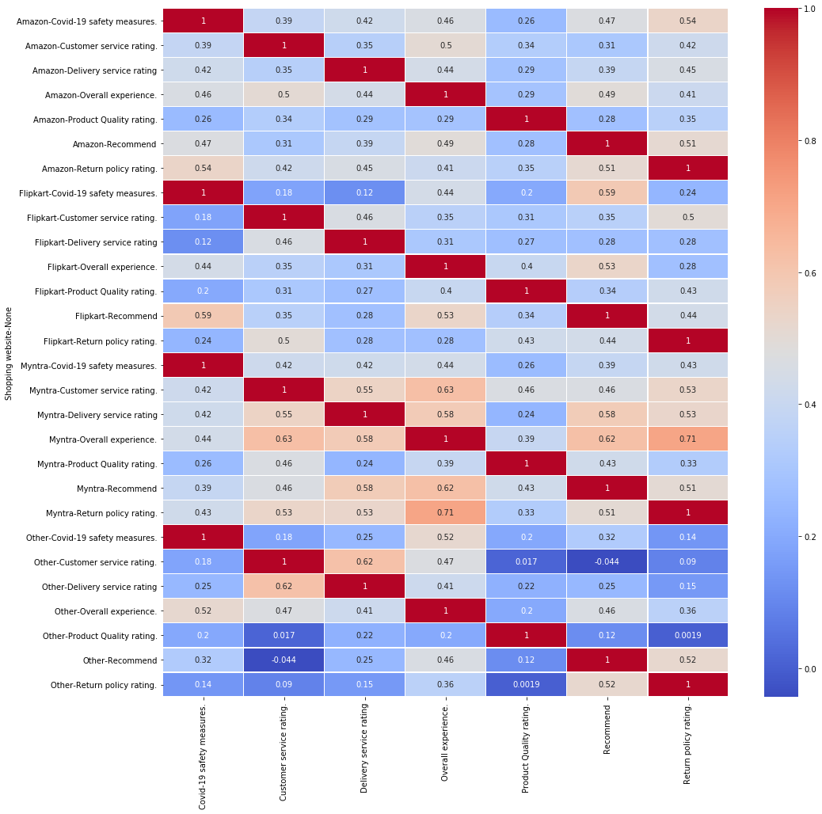

Slide 21
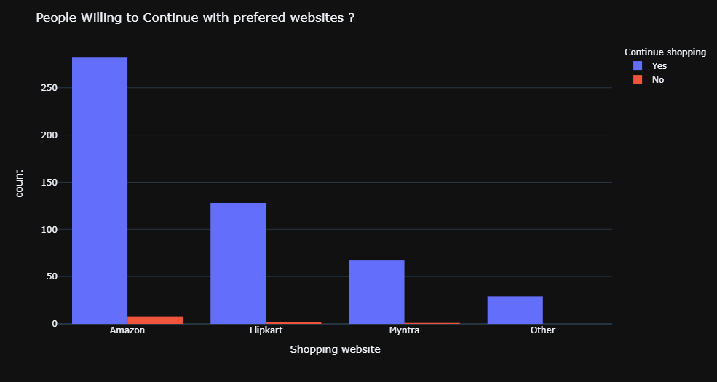
Are Users willing to change their proffered Website ?
Conclusion : It is Seen that Most of the Users do not agree with Changing their Preferred Website Choice.

Slide 22
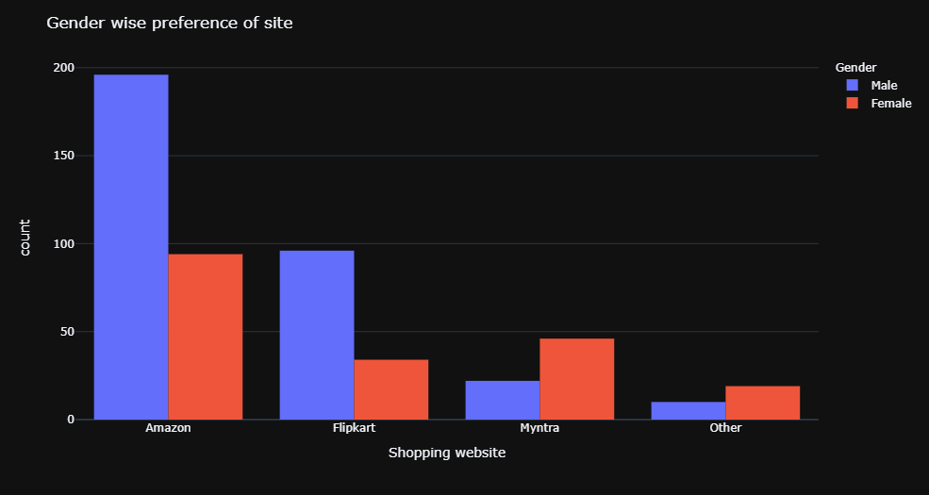
Websites Preferred According to Gender

Slide 23
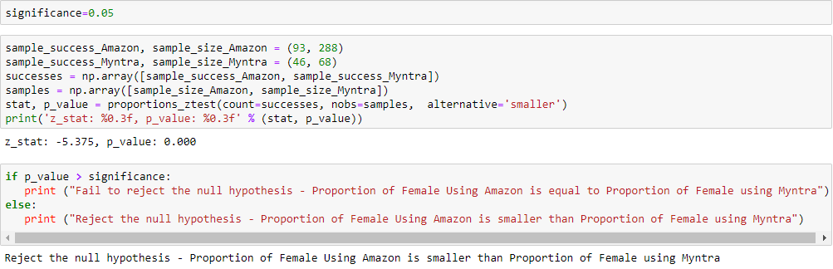
Amazon has 93 females out of 288, and Myntra has 46 females out of 68. is there a significant difference between the proportion of females using amazon and Myntra ? Conclusion : Myntra has more of female users proportion than male users which is not the same in case of amazon and flipkart.

Slide 24
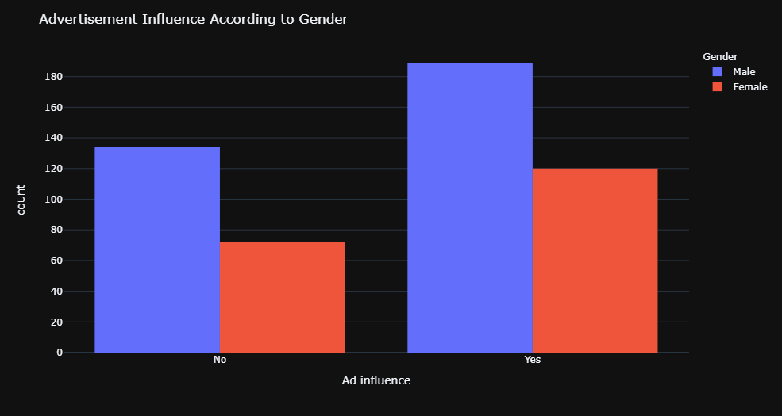
Advertisement Influence According to Gender

Slide 25
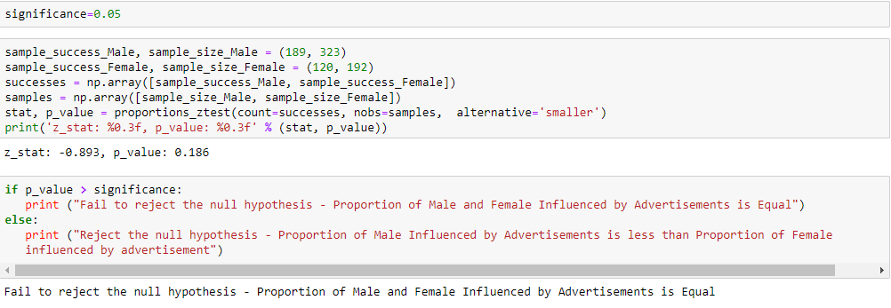
189 of 323 males and 120 of 192 females are influenced by ads. Is there a significant difference between proportion of female and male influenced by advertisements ?
Conclusion : There is no significant difference between proportion of male and female influenced by advertisements

Slide 26
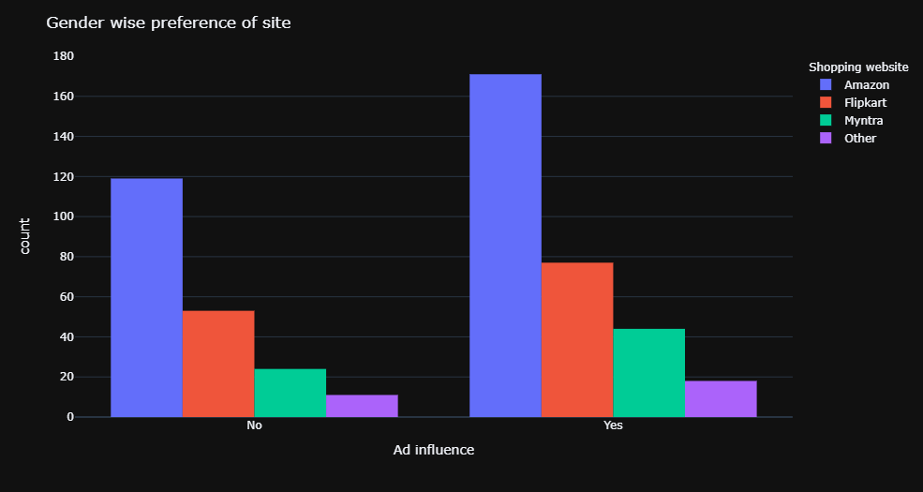
Advertisement Influence according to Websites

Slide 27
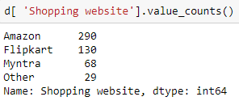
171 of 290 amazon users and 44 of 68 Myntra users are influenced by ads. Is there and any significant difference between proportion of amazon and Myntra users influenced by ads ?

Slide 28
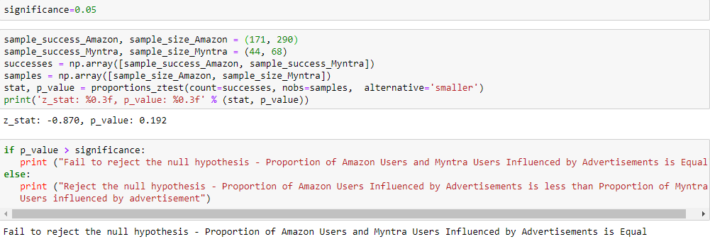
Conclusion : There is No Significant difference between Proportion of Amazon and Myntra Users Influenced by Advertisement.
i.e. We cannot say that Advertisement of Particular Shopping Website
Influences Customers More than that of other.

Slide 29
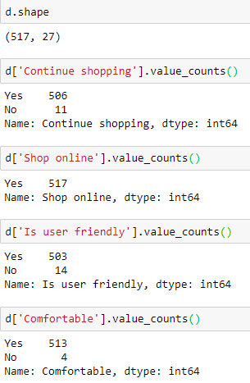
Data Pre-processing

Slide 30
Column ‘Continue shopping' has Unbalanced data and indirectly ‘Switch to ?' too.
Similarly 'City' column is unbalanced too.
‘Shop online' has only 'Yes' as entries and hence has no Significance effect on data.
Similarly Columns ‘Is user friendly ' and ‘Comfortable' have the Majority of the entries as 'Yes' and Very few as 'No'. Hence we drop these two variables as well

Slide 31
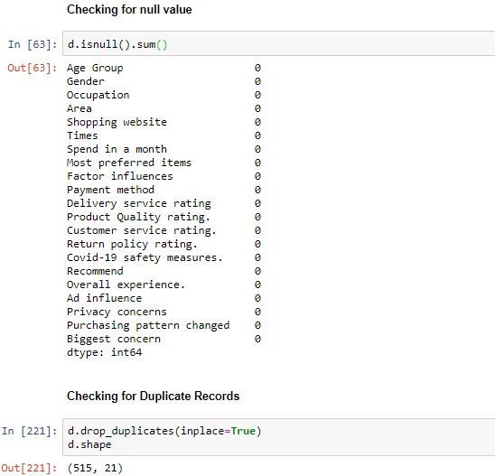
d.isnull().sum()
d.drop_duplicates(inplace=True)
d.shape
Conclusion :
1] There are no null values in data.
2] There were 2 duplicate records.

Slide 32
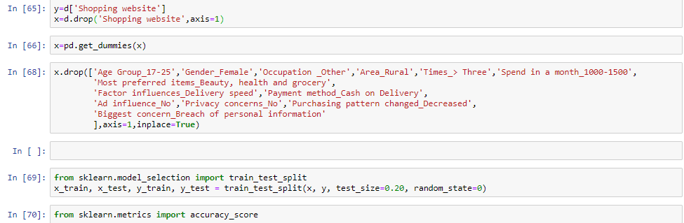
Preparing Data

Slide 33
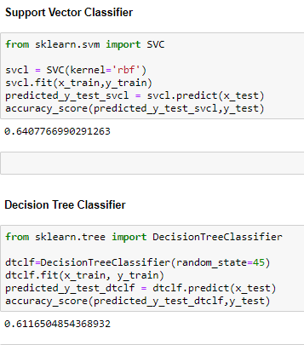
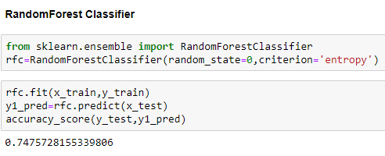
Model fitting

Slide 34
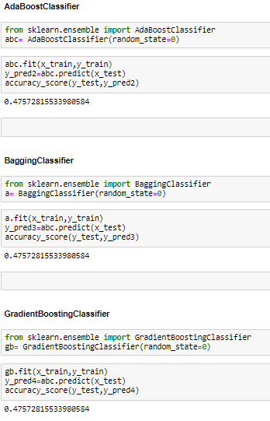

Slide 35
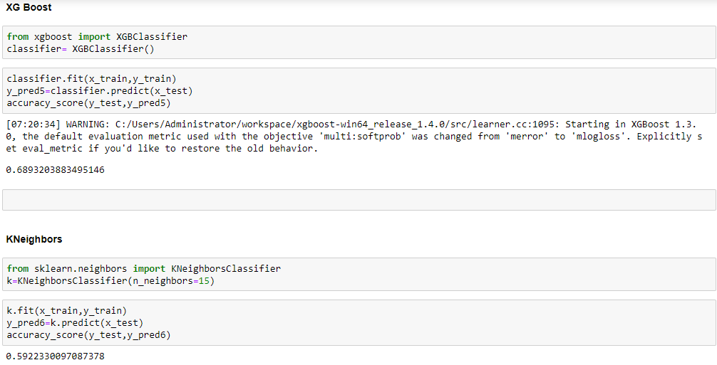

Slide 36
Conclusion
1] Random Forest has highest Accuracy of 74.76 % .
2] XG Boost has 2nd Highest Accuracy of 68.93 % .
3] SVC, Decision tree have accuracy of 64.08 % ,
61.17 % respectively.
But are these Accuracies reliable ? So in Order to verify it we further use cross validation technique.
Why cross validation ?
The Cross validation technique fits and tests the model on multiple training and test sets. At last, takes mean of all the accuracy scores to give the final one.
It Also Helps to Overcome the Problem of Overfitting.

Slide 37
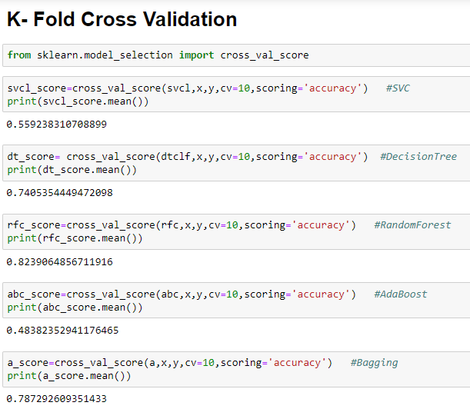
Cross Validation

Slide 38


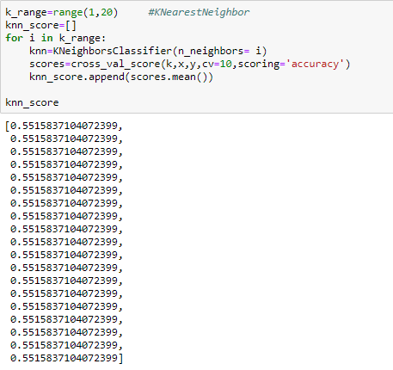

Slide 39
Conclusion
1] Random Forest has the Highest Accuracy of 82.39 %.
2] Bagging, XGBoost, Decision Tree have Accuracy of 78.73 % ,
77.19 % , 74.05 % respectively.
3] This Means that Random Forest is the Best Fit Model on our Data.

Slide 40
Overall Interpretations :
1] 94% of people prefer online shopping.
2] Amazon is the Most Preferred Website followed by Flipkart And Myntra.
3] Offers influence Buyers the Most while Online Shopping Website.
4] Product Quality and Unavailability are the Main Concerns During Online
Shopping.
5] We can Observe that the Customers Prefer Traditional Method i.e Cash on Delivery
more than the Other Methods.
6] Proportion of Male Preferring Credit Card is Greater than Proportion of Female.
7] Overall Buying pattern in the Covid-19 situation seems to be decreased.
8] 60 % of Buyers are Influenced by Advertisement While Online Shopping.

Slide 41
9] Overall online experience of Customers buying through Myntra is Good Maybe
due to their good return policy.
10] It is Observed That Most of the Users are Loyal to their Preferred Websites.
11] Myntra has more female users proportion than male users which is not the same in the case of Amazon and Flipkart, So to increase the sale Myntra can Focus More on Female Products.
12] Products >2000 Rs. Contributes More for Amazon in comparison with its Competitors. Flipkart and Myntra Must Focus on Products in this Category to Increase Overall Sales.
13] Random Forest is the Best Fit Model on our Data.
Companies have Databases of Non registered Customers. Using this Model Companies can Identify their Target Customers and Work Accordingly.

Slide 42
THANK YOU

